Slide 1

RITHIM Harmony
User Interface Upgrade

Slide 2
Accessibility Summary
This Presentation includes the following Accessibility Features:
  Text Size: 18 pt or larger.
  Proper use of punctuation to aid screen reader cadence.
  Alt Text: Included to describe all non-decorative images.
  Colour Contrast: Minimum 4.5:1 for normal text.
  Keyboard Navigation:
    All interactive elements in this presentation are operable via Tab/Enter.
  Link Text: Uses meaningful text, not raw URLs.
  Reading Order: Verified logical order of slide contents.
  Language: Consistent terminology and defined acronyms.
  Subtitled videos.
  Please note that for Harmony system navigation, the interactive elements described in this presentation are operable via the Tab and Spacebar keys, in addition to mouse navigation.

Slide 3
Presentation Index
This Presentation contains the following (each item has a link directly to that section):
Section: Current Interface
Section: New Interface
Section: Videos

Slide 4
Section: Current Interface

Slide 5
Current Interface
The current Harmony interface is configured as follows:
  Menu Bar: Top left of the screen containing Work Area, Contacts, and Help links.
  Username Dropdown: Top left of the screen for Change Password, Personal Details, Notifications and Logout.
  Actions and Navigation Tiles: left side below the Menu Bar containing system action and navigation tiles which are dependent on the area of focus within Harmony and contain tiles such as Create Project, Duplicate Project, Completeness Check, View as PDF, etc.
  Work Area: Navigation tiles for Notifications, Signatures (Requests), Transfers (Projects) and Shared (Projects).
  Project Folders: Navigation Tiles for All Projects, Imported Projects and Imported & Validated (Projects) (if you have had projects imported from UM as the Principal Investigator). This area would also contain any custom project folders that the user has created.
  Projects (List): A list of all projects (or selected projects by folder) and includes Project Title, Project ID, Owner, Date Created and Date Modified.

Slide 6
Current Interface Summary of Changes
The following areas of the Harmony interface are changing:
  Menu Bar is changing.
  Actions and Navigation are changing.
  Username and Account Details are changing.
  Work Area - Notifications are changing.
  Work Area Signatures, Transfers and Shared are not changing.
  Project Folders are not changing.
  Projects (List) are not changing.

Slide 7
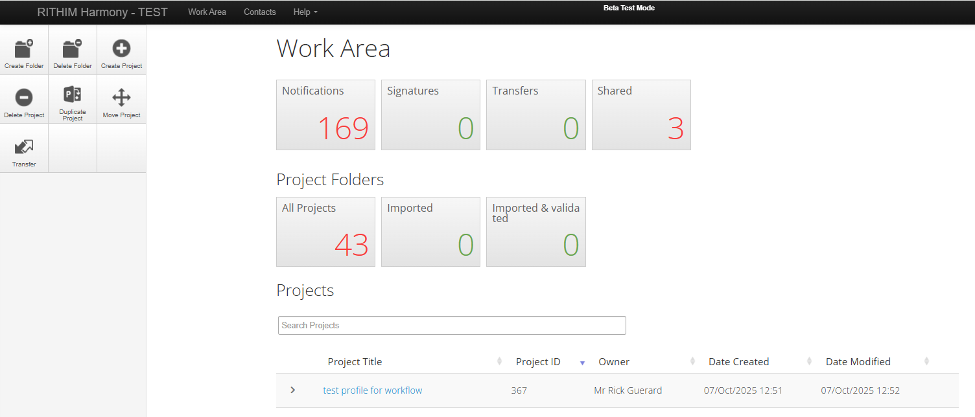
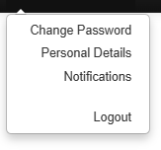
Image of Summary of Changes
Username and Account Details
Changing
Username
Menu Bar Changing
Work Area
Notifications Changing
Signatures, Transfer, Shared, NOT changing
Actions & Navigation
Changing
Project Folders
(NOT changing)
Projects List
(NOT changing)

Slide 8
Section: New Interface

Slide 9
New Interface Changes
The new Harmony interface is configured as follows:
  Menu and Navigation Bar: Left side and contains links to: Work Area, Projects, Contacts, Signatures and Transfers.
  Top right now contains:
    A Question Mark icon for access to: Contact Information (Contact Us at RITHIM), Help, FAQs, Templates and About.
    A Notifications bell icon, which will indicate when notifications are present and allow navigation to the Notifications section of Harmony.
    Account bubble icon with user initials for access to: Change Password, Personal Details, Notifications (same access as the Notification bell icon) and Logout.
  Work Area: Signatures, Transfers, Shared (Projects), Project Folders and Projects (List) remain within the work area.
  Actions: System actions will be located above the Projects (List) and include actions such as Create Project, Create Folder, Transfer, etc.

Slide 10
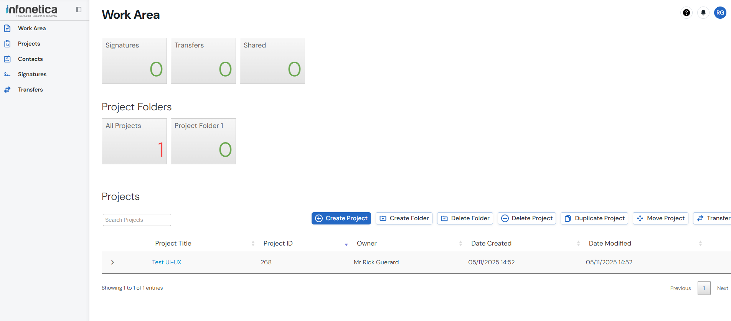

New Interface Image
Username and Account Details
Notifications
Menu Bar & Navigation
Actions

Slide 11
Section: Videos

Slide 12
Infonetica Videos
The following videos were created by Infonetica (Harmony vendor).
Although the branding and some aspects of the configuration are different than Harmony, the basics of the changes are well highlighted in these videos.
It may be helpful to have Harmony open while viewing this video to allow for cross-checking of the changes.

Slide 13
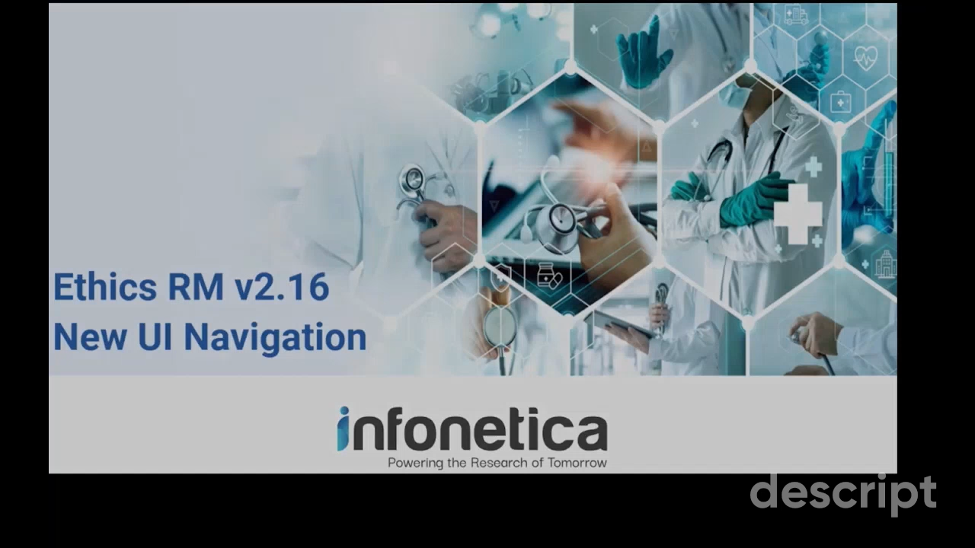
General Information
This video is presented from the Applicant perspective, but contains essential information for all users.
Note: If you have trouble viewing this video in-app, please view the video on Youtube here.

Slide 14
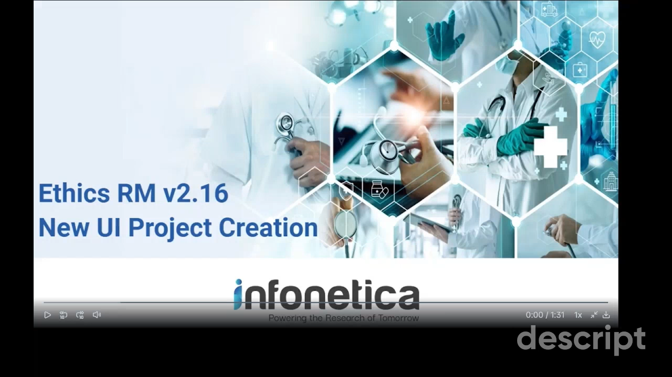
Applicant Changes
Note: If you have trouble viewing this video in-app, please view the video on Youtube here.

Slide 15

Reviewer Changes
Note: If you have trouble viewing this video in-app, please view the video on Youtube here.

Slide 16

Support
For questions or support, please create a support ticket in the Harmony Support Site. (click link).

